Slide 1

MapEmbed: Perfect Hashing with High Load Factor and Fast Update
KDD’21, August 14–18, 2021, Virtual Event, Singapore.
Yuhan Wu∗, Zirui Liu∗, Xiang Yu∗, Jie Gui∗, Haochen Gan∗,
Yuhao Han‡, Tao Li‡, Ori Rottenstreich§, Tong Yang∗
∗Peking University, China; ‡National University of Defense Technology, China; §Technion, Israel
Notes:
Thanks for the introduction.
Hello everyone!
I’m Yuhan Wu. I just got my bachelor degree from Peking University.
Today I will present our work: MapEmbed Perfect Hashing with High Load Factor and Fast Update.

Slide 2

01
Part One
Background
Notes:
Let’s begin with the background of perfect hashing.

Slide 3
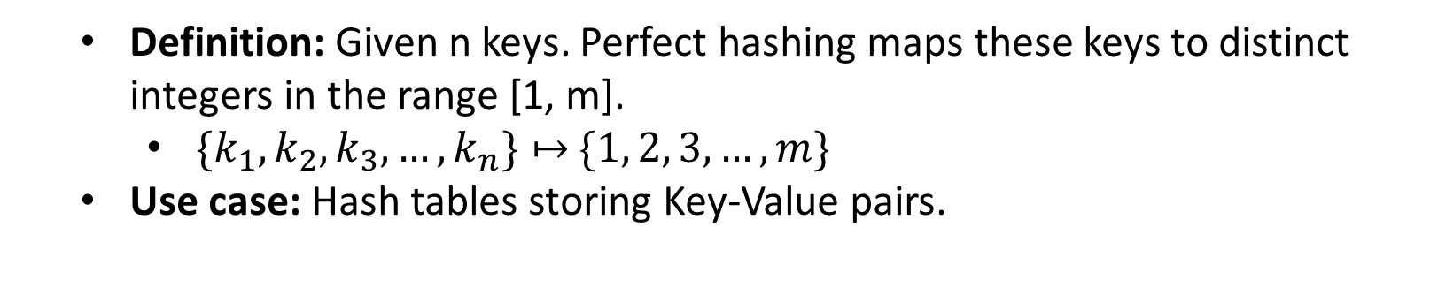
Perfect Hashing
Definition: Given n keys. Perfect hashing maps these keys to distinct integers in the range [1, m].
$\{k_{1},k_{2},k_{3}, …,k_{n}\}↦$ $\{1, 2, 3, …,m\}$
Use case: Hash tables storing Key-Value pairs.
1
2
3
4
5
6
1
2
3
4
5
6
A
A
B
B
C
C
Common hashing
with n=3, m=6
Perfect hashing
with n=3, m=6
Notes:
Hashing is one of the most fundamental techniques in computer sciences.
Given n keys, a common hash function can map these keys to m integers randomly.
The perfect hashing is a special hash function that can ensure the output n integers are different from each other.
In other words, there is no two different key maps to the same number.
In the example on the left, a common hash function maps three keys A,B, and C to 3 3 and 5.
Key A and B are mapped to the same value.
In the example on the right, the perfect hashing maps these keys to distinct integers 2 3 and 5.
Perfect hashing is often used to construct a hash table.

Slide 4
Perfect Hashing
Use case: Hash tables storing Key-Value pairs.
Structure
a small index in fast memory (e.g., CPU Caches, SRAM in FPGA).
It includes the perfect hash function.
a large Key-Value table in slow memory (e.g., DDR, DRAM).
Pros: eliminate hash collisions
One slow memory read when querying
Small index structure (e.g., 1.6 bits per key)
Cons: static construction
Hard to add or modify the key (incremental updates).
A
B
C
Small Index in fast memory
Perfect Hash Function
1 | 2 | 3 | 4 | 5
Large Key-Value Table in slow memory
Notes:
The hash table consists of two parts: a small index and a large Key-Value table.
The index is the perfect hash function. It is often small enough to be placed in fast memory (like CPU Caches, and SRAM in FPGA)
The large Key-Value table stores all key value pairs. It is larger and is placed in slow memory (like DDR [7] and DRAM [8]).
When constructing the hash table, it first takes all keys and constructs a perfect hash function for them.
The Key-Value table consists of m slots. Each slot can store one key value pair.
Every output value of the perfect hash function corresponds to one slot in the a large Key-Value table.
For each key, we calculate its perfect hashing output, locate a slot and store the key value pair there.
When query the value of a key, we access the corresponding position to read the value.
The advantage is that it can eliminate hash collision when querying. It needs only one slow memory read at most after calculating the hash output. So that it can provide good query latency guarantees in the worst case.
In addition, the index is quite small and memory efficient. We just store the parameters of the perfect hash function in the index. It is much smaller than the total size of full keys. For example, it only consumes 1.6 bits for each key in fast memory.
However, most existing perfect hash schemes are static. It means that they construct the hash function based on all given keys. After the construction, it’s hard to incrementally add or modify the key. They are called incremental updates.

Slide 5
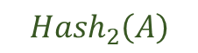
Related work: Dynamic Perfect Hashing
Dynamic Perfect Hashing illustration
Index Table
Weakness
Low load factor（<20%）
Slow updates
A
B
C
D
Hash
Change the hash function
$${Group}_{1}$$ | $${Group}_{2}$$ | $${Group}_{3}$$ | $${Group}_{4}$$ | $${Group}_{5}$$
$${Hash}_{2}\left(A\right)$$
Collision
KV Table
D
C
Notes:
Among existing work, only Dynamic Perfect Hash (DPH) [18] supports incremental updates.
Its key idea is to divide all keys into many small groups, and for each small group, it finds a hash function without collision by brute force.
Every time a collision happens, it reconstructs the small group by changing its hash function. The reconstruction stops until there is no collision.
In this example, A and B are mapped to the same group. C and D are mapped to the same group. But they are mapped to the same slot, a collision happens. Then, the algorithm reconstructs the group by changing the hash function of the group. After that, there is no collision.
However, to control the reconstruction time, it needs to use a oversized table for each group.
Only about 20% positions can be used to store the key value pairs. It is inefficient in storage.
Besides, its update speed is not fast enough.
We want to construct a memory-efficient perfect hashing table with high load factor and faster incremental update speed.
At the same time, we keep the advantages of existing work including one slow memory access, and small index structure.

Slide 6

02
Part Two
Algorithm
Notes:
Next, we introduce our algorithm.

Slide 7
MapEmbed Hash Table
Structure
Map
Step1: key
↓
cell
Step2: key + cell
↓
virtual bucket
Embed
Step3: virtual bucket
↓
real bucket
KV pairs
A
B
C
Map
Index Table
Step 1
0 | 0 | 0 | 0 | 0 | 0 | 0 | 0 | 1 | 0
Cells
1
Step 2
C
Virtual Buckets
Virtual Table for each cell
A
B
Fast Memory
Step 3
Embed
KV Table
A
C
Real Buckets
B
Slow Memory
Notes:
Our key idea is called Map and Embed.
We map all keys into large number of tiny virtual tables, and then we embed all these virtual tables into one real table.
We use an example to present the two phases. As shown in the Figure, the hash table consists of two parts:
an index table in fast memory and a large KV table in slow memory.
The index table is an array of index cells, each cell stores one integer. Every cell corresponds to a
small virtual table consisting of virtual buckets. Each virtual bucket can store multiple Key Value pairs. The virtual table is a logical concept and does not really exist in fast memory.
First, in the map phase, we map each key into a virtual bucket by two steps. We hash the key to a cell, and then hash the key to a virtual bucket in the Virtual Table corresponding to the cell.
Second, in the embed phase, we map each virtual bucket to a real bucket in the slow memory by hashing. The total number of virtual buckets in all tables is larger than the number of real buckets. This is an idea of sharing. A relatively large number of virtual buckets share a small number of real buckets.
For example, we insert key A. It is hashed to a cell, then the virtual bucket, and the corresponding real bucket.
If no real bucket in the slow memory overflows, the embed phase succeeds.
Otherwise, we circularly move the keys in the virtual table and try to embed them again. Specifically, for all
keys in the virtual table, we will move them to the next adjacent virtual bucket. We move the key in the i-th virtual bucket to the (i +1)-th virtual bucket and move the key in the last virtual bucket to the first virtual bucket. We repeat the circular movement again and again until there is no real bucket overflow.
The number of circular moves is recorded in the cell in fast memory as the parameters of our hash function. This is also an offset number.
In this example, B and C are mapped to the same cell as A.
when we insert C, a collision happens. We circularly move the keys in the virtual table and the corresponding real buckets. And we increment the recorded number in the cell by 1.
Among the three steps, only the step 2 can be adjusted by modifying the parameter recorded in the cell.

Slide 8
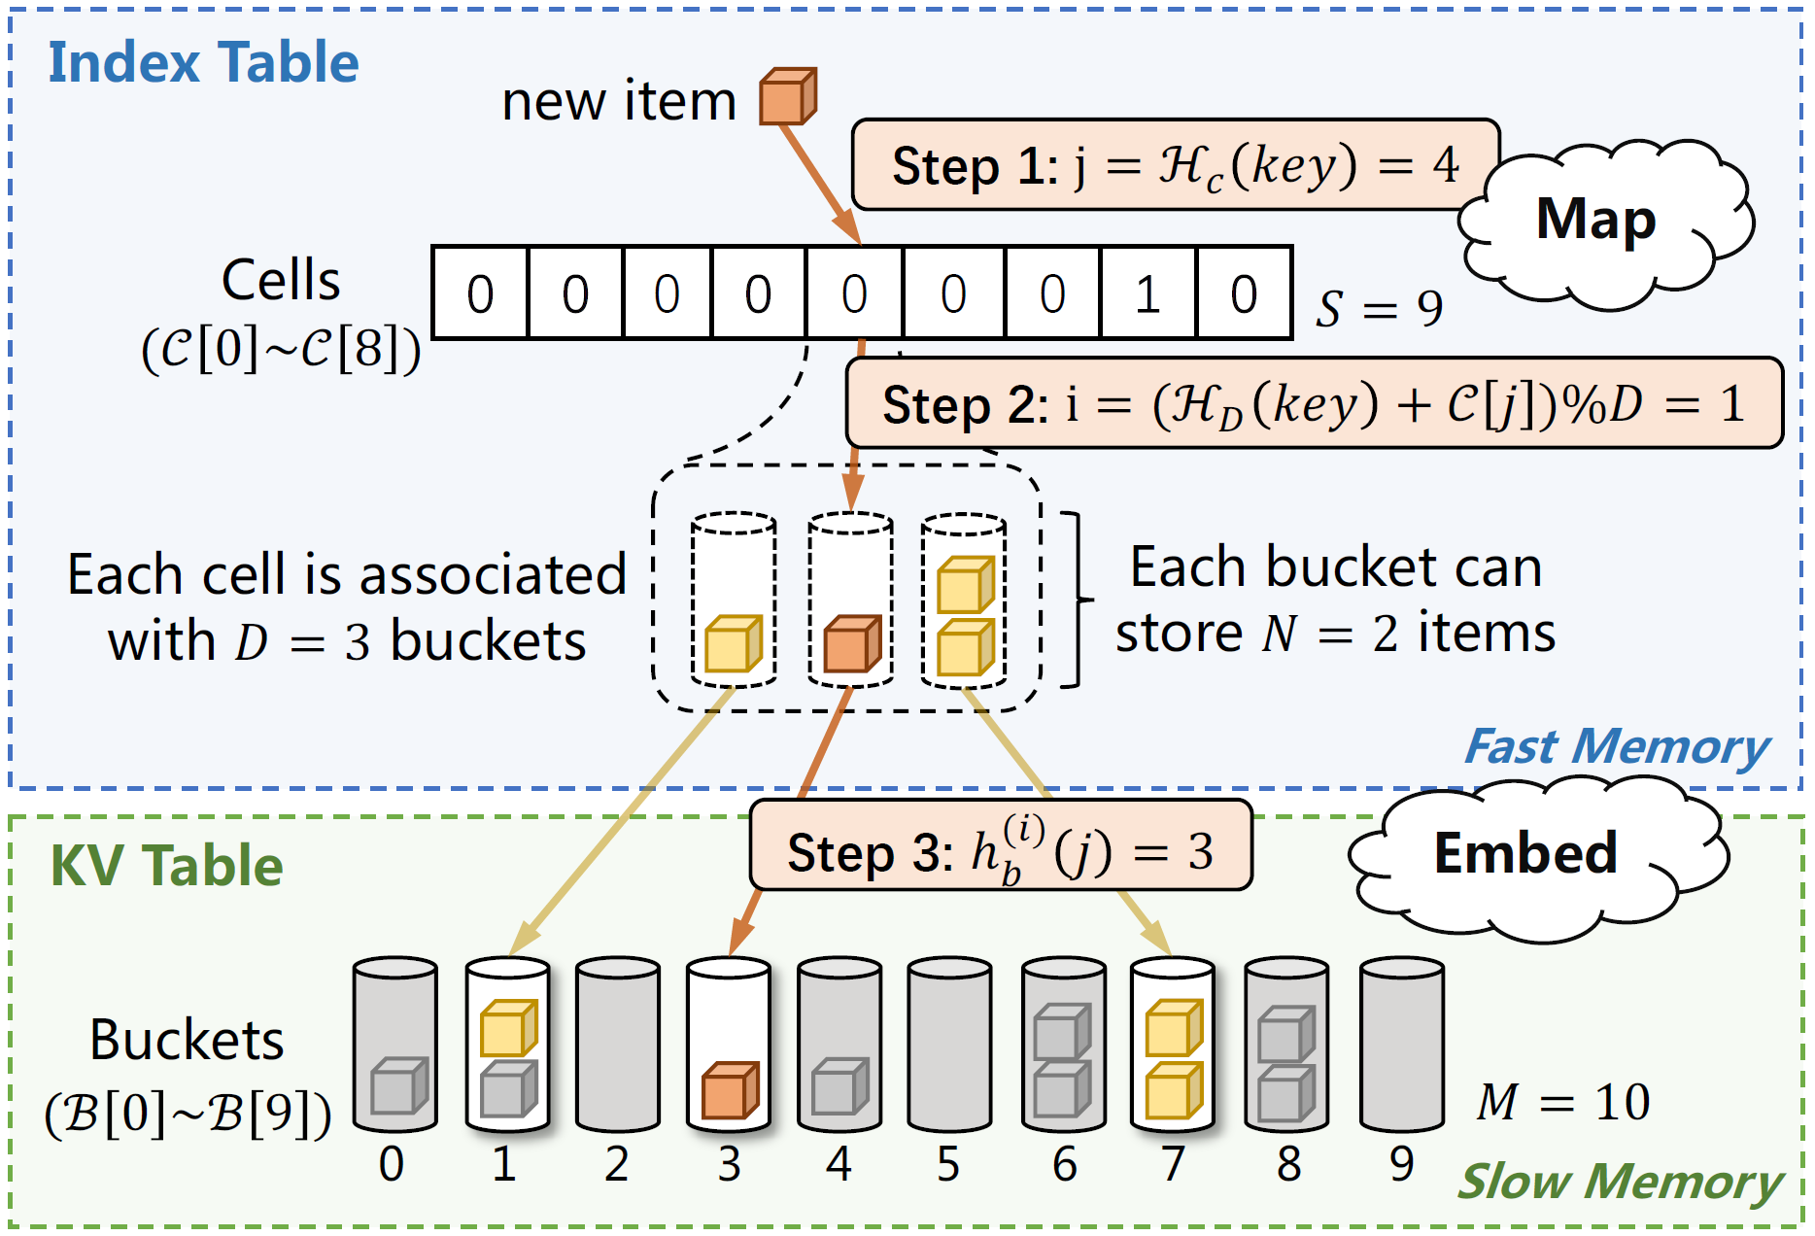
MapEmbed Hash Table
Notes:
Next, we will introduce the key details of the algorithm.
when we insert a new key value pair, first we use a common hash function Hc to hash the key into a cell. The j-th cell
Then we use another common hash function HD to hash the key to a virtual bucket, and then add the index of the bucket by C[j]. The C[j] is an offset. It is also the number of circular movement in this cell.
Then for the i-th virtual bucket in the j-th cell, we hash it to a real bucket.
We store the key-value pair in the real bucket.
When querying the key, we use the same three steps to find the real bucket and find the key value pair we need in the bucket.

Slide 9
MapEmbed Hash Table
Strength
High load factor (>90%)
Technique: Embedding and memory sharing.
Small index (0.5~1.6 bits per key)
Technique: Storing the offset (# of circular move).
Fast incremental update
Technique: Fast offset computation without changing hash functions.
Notes:
So, what’s the advantage? Why we choose this design?
First, it is memory efficient with high load factor, because it embeds large number of virtual buckets to real buckets by circular movement.
These virtual buckets share the slow memory.
In addition, the size of each virtual table is fixed. For example, 8 buckets in each table. We don’t need dynamic memory allocation.
Second, the index in the fast memory is small, because we only store the offset. That is the number of circular moves in each virtual table. In our experiments, one cell only uses 4 bits. On average, each key only needs 0.5 to 1.6 bits in the index.
Third, the speed of incremental updates is fast, because we don’t change hash functions, we just move the keys circularly without complex hash computation. When we perform multiple times of circular moves, we don’t need to move all keys in every move. We just count how many keys in each virtual bucket, and then count the empty slots in every corresponding real bucket. Based on the counting, we can find a proper number of circular moves.
But there is still a problem. What if the circular move fails? In this figure, we will go back to the initial state after we circularly move three times. What if we cannot avoid overflow in any way?
We use multi layer cells to handle this problem.

Slide 10
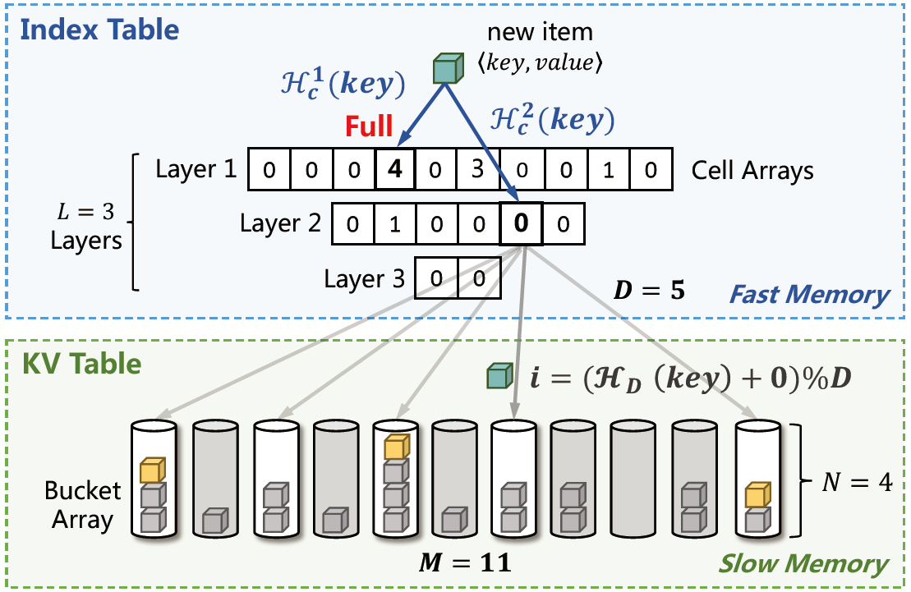
MapEmbed Hash Table
Multi-layer version: We divide the cell array into multiple layers.
Notes:
To handle the overflow and improve the load factor , we propose the multi-layer version of MapEmbed.
We divide the cell array into three layers.
If we cannot eliminate the overflow in a cell of the first layer by circular movement, we find all key value pairs in the cell’s virtual table, and then insert them to the second layer,
Each layer uses independent hash functions. The first layer is the largest layer and the size of subsequent layers decreases layer by layer.

Slide 11

03
Part Three
Experiments
Notes:
Next, we present our experimental results.

Slide 12
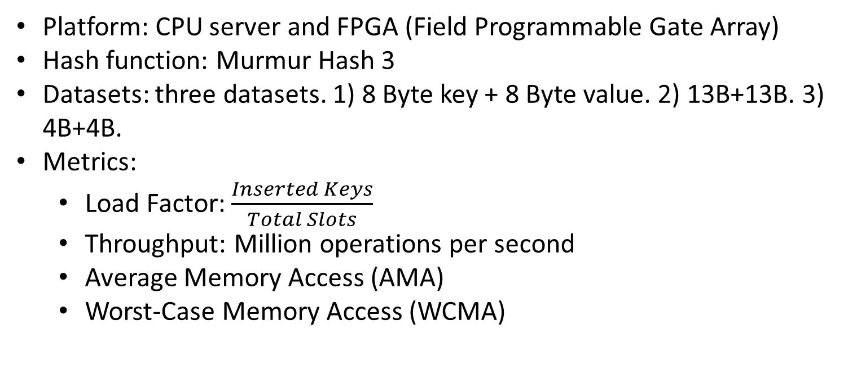
Experiments
Platform: CPU server and FPGA (Field Programmable Gate Array)
Hash function: Murmur Hash 3
Datasets: three datasets. 1) 8 Byte key + 8 Byte value. 2) 13B+13B. 3) 4B+4B.
Metrics:
Load Factor: $\frac{Inserted Keys}{Total Slots}$
Throughput: Million operations per second
Average Memory Access (AMA)
Worst-Case Memory Access (WCMA)
Notes:
Our experimental platform is a CPU server and a FPGA (Field Programmable Gate Array)
Our basic hash function is murmur hash.
We use three datasets. Their key-values have different lengths and different distributions.
We use four Metrics to evaluate the performance.
The load factor is the percentage of slots that stores key value pairs in slow memory. The higher the load factor, the higher the memory efficiency.
The throughput shows the speed of inserting one key or querying one key.
We also count the number of memory access in both fast and slow memory.
In addition, we count the worst case memory access number.

Slide 13
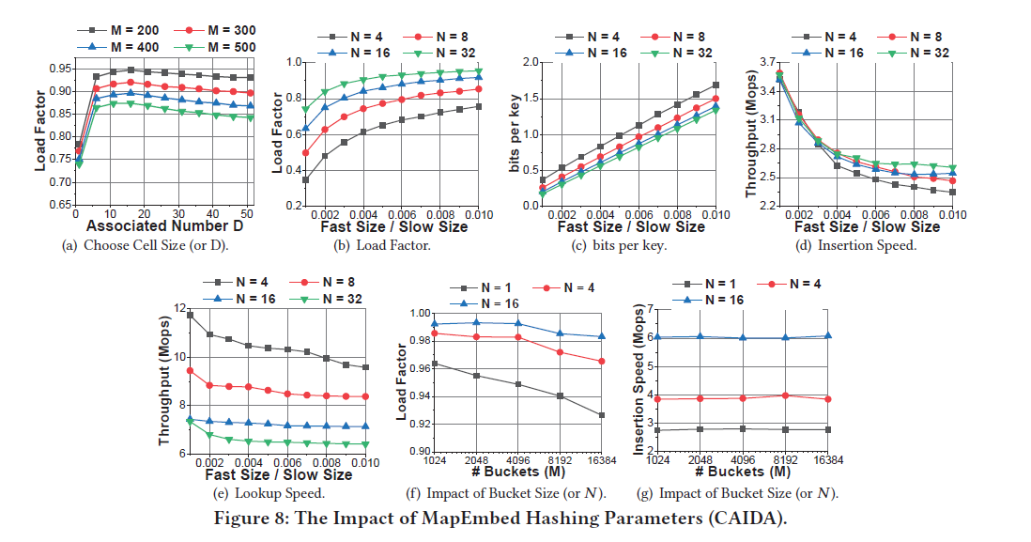
Experiments
Notes:
We perform comprehensive experiments to show the performance of the algorithm with different parameters. And we select a set of default parameters based on experiments.

Slide 14
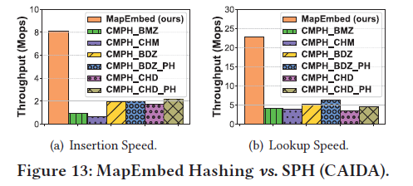
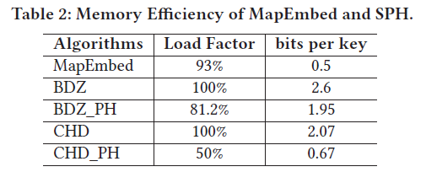
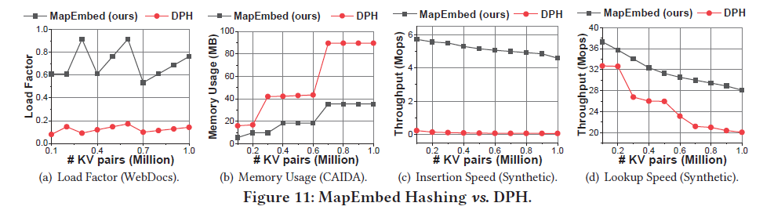
Experiments
Notes:
Our experimental results show that our MapEmbed outperforms existing static perfect hash and dynamic perfect hash.
Compared with static perfect hash, our MapEmbed supports incremental updates and has faster construction and lookup speed. But we cannot achieve 100 percent load factor as many static perfect hashes do.
Compared with dynamic perfect hash, our MapEmbed performs much better than existing work in both memory efficiency and processing speed. MapEmbed improves the insertion speed 20 times, and improves the load factor to more than 90%.
Its index structure is quite small. It only consumes 0.5 to 1.6 bits per key.

Slide 15
04
Part Four
Summary

Slide 16
Conclusion
MapEmbed perfect hashing table
Fast incremental updates and lookups
High load factor in slow memory
Small index structure in fast memory
Future work
More theoretical analysis
More scenarios of perfect hashing
Notes:
In conclusion, we proposed mapembed. It supports Fast incremental updates and lookups, High load factor in slow memory and Small index structure in fast memory
In the future, we will try to conduct more theoretical analysis and find more scenarios of perfect hashing.
We are happy to answer your questions.

